Slide 1

OIL DISTRIBUTION ANALYSIS

Slide 2
Table of content
Introduction
Background
Analysis
Data Collection
Data Cleaning
EDA – Exploratory Data Analysis
Visualization
Insight
Recommendation

Slide 3
Introduction
Oil as we know is one of the essential materials that mother earth has blessed the human race with. Although its a free gift from nature, nonetheless government agencies around the globe, and some individuals (licensed by the government) are able to own a significant portion of this mineral resource by being able to explore areas where its found. Thereby making it available to the masses at the prevailing price overtime.

Slide 4
Background
The Oil/Gas dataset contains useful information such as the GDP per capita - the measure of the economic output per person in a nation - price per gallon of oil and also the price per litre of oil among other information, which after our analysis, we see how the GDP per capita in various nations affects not only the selling price of oil, but also the daily consumption of it despite having a standardized price .

Slide 5
ANALYSIS

Slide 6
Data collection
The datasets was downloaded from Kaggle using the link provided by the Octave data & analytics team.
Data cleaning
To ensure that our dataset was clean and ready for exploration and visualization, a procedure known as data cleaning had to be carried out. This involved the removing of unnecessary columns, filtering the data, and converting the data types of certain to their required datatypes amongst other procedures.
Exploratory Data Analysis
The following procedures were carried out as part of the EDA process to enable us properly understand the dataset so as to provide actionable insights from it:
Merging of the two datasets provided and saving it as a single file
Checking the correlation between the columns of the newly formed dataset
Drop duplicates
Sort values according to country
Reset index
Created and parsed in an iso-alpha3 country-code as column into the dataset

Slide 7
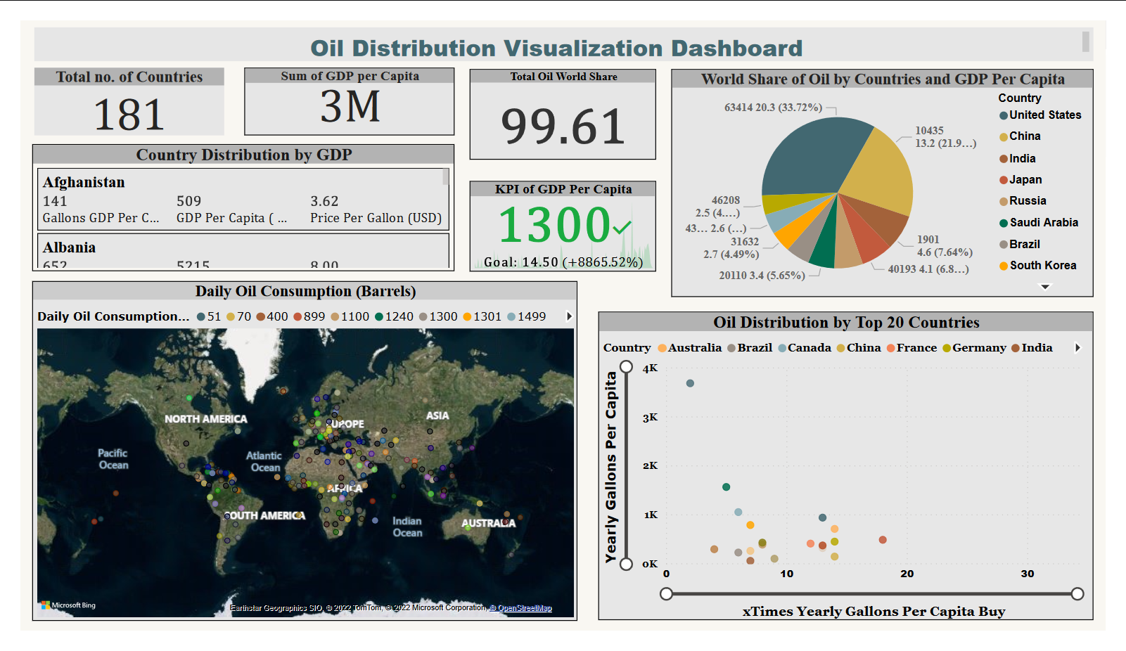
Data visualization

Slide 8
Insights
We discovered the following while exploring the oil datasets,
Columns like the Daily Oil Consumption (Barrels), GDP Per Capita ( USD ), Gallons GDP Per Capita Can Buy, and its likes can all be gotten by carrying out basic arithmetic operations.
It was largely observed that nations whose GDP per capita appeared to be high purchase oil at a higher rate per gallon.
The cumulative GDP per capita performed quite well as the key-performance-index (KPI), when the price per litre was and price per gallon were used to measure it.
Several nations from developing & under-developed countries with a low GDP per capita are also low ranked when it comes to the distribution of the world share oil.
The larger percentage of oil distribution, consumption and world share were occupied by nations that appeared to be technologically advanced.
Despite being able to consume daily barrels of oil >10,000, some nations because of their GDP per capita in proportion to their price per gallon, still experienced low annual purchase of oil per capita.
A barrel of (crude) oil = 42 gallons (in the US), while 1 gallon of oil = ~4 litres of oil (precisely, 3.7854 litres). Which is also the standard measure for oil, this further proves that the values provided in the dataset are accurate and the analysis true.

Slide 9
Recommendation
Having properly examined the dataset, below are the recommendations to those nations who have very little or no dominance of oil share in world. First, It’s important to state that based on the analysis, these three(3) features seems to stand out among nations who dominant the oil market.
These nations are more technologically inclined and advanced
Have a relatively high GDP per capita, and
The quality of education offered in these countries are of world class standards
With these,
We strongly recommend that the government of such nations make plans and take steps to have a truly diversified economy, and not entirely rely on just one economic resource.
The government of such nations take to advance their nations technological frontiers as this has proven to one major way a nation can help improve the standard of living of her citizens.
Nations who are oil producing states should ensure adequate funds are put in place to ensure that oil is being refined within its borders, thereby increasing the employment rate which would in effect increase the GDP per capita.
A revamping of the educational sector of such nations would also go along way to increase the employability index (score) of her citizens, hence making sure that they can compete on the global scene which would in turn increase in the GDP of their nations.

Slide 10
Thank you

